Slide 1
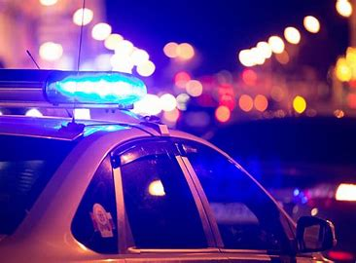
Police Incident Coverage Time Capstone
by Donovan Knight
Nashville Software School DA10

Slide 2
Motivation
To identify if the Nashville Police Department reputedly respond slower or faster in certain areas based on the demographic of people living there
To gain insight on the patterns of what people call the police for
To possibly shed light onto misinformation about the police in our city
To aid in lessening the hostility between on-duty officers and citizens

Slide 3
What is Police Incident Coverage Time ?
Time between the incident occurred and the incident reported by the police
Incident occurred = instance in which a call is made for dispatch to make their way to the scene
Incident reported = instance in which the call has been handled and put in the Metro Nashville Police Department system
This is not the same as response time. This an indirect measure of it.

Slide 4
Additional Police and Personal Data Information
Only 1,050 officers spread across 8 precincts/districts that span across Nashville
Not evenly divided across each precinct, but based on budget and calls for service
Median times were taken to account for outlying coverage times in dataset
Some data was eliminated from my work because of irrelevant zip codes, nonexistent zip codes, etc.
Data only spanned over 2023
Suspects on the run for more than a day were not included in the incidents reported

Slide 5


Parameters
Race
Income

Slide 6
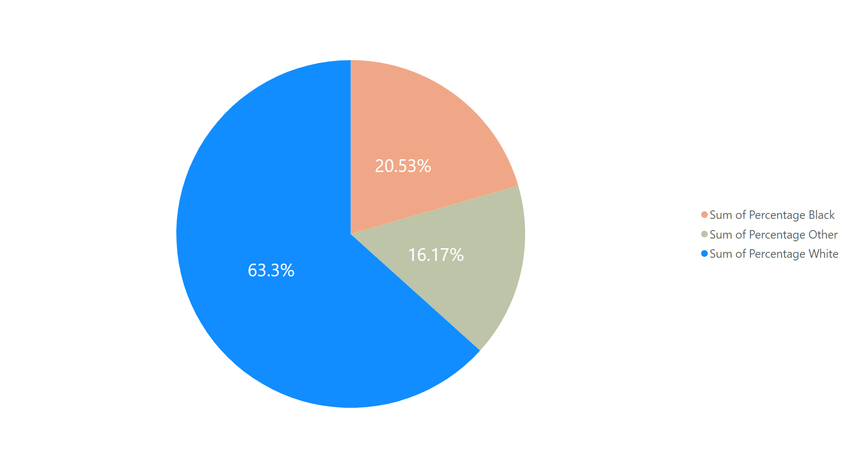
Race in Nashville
Blue – White Population
Peach – Black Population
Olive – All Other Populations

Slide 7
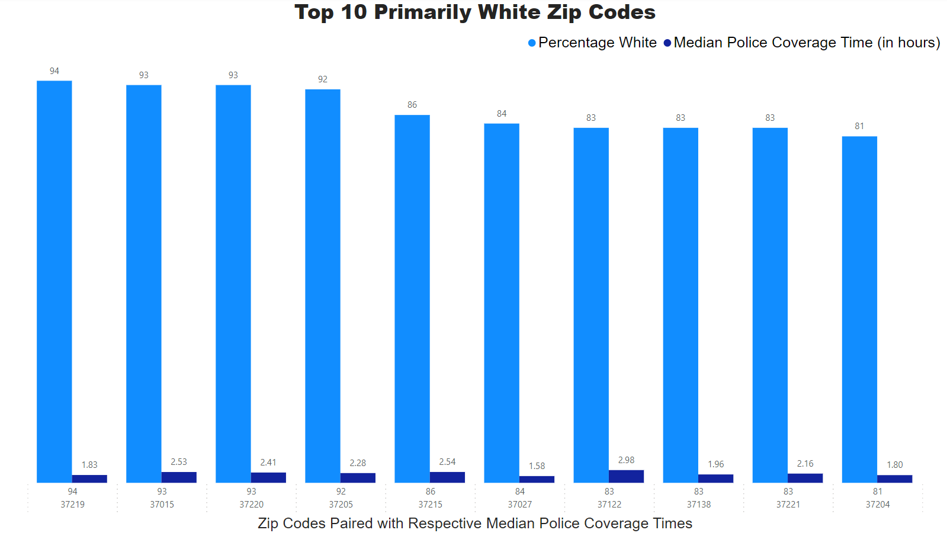
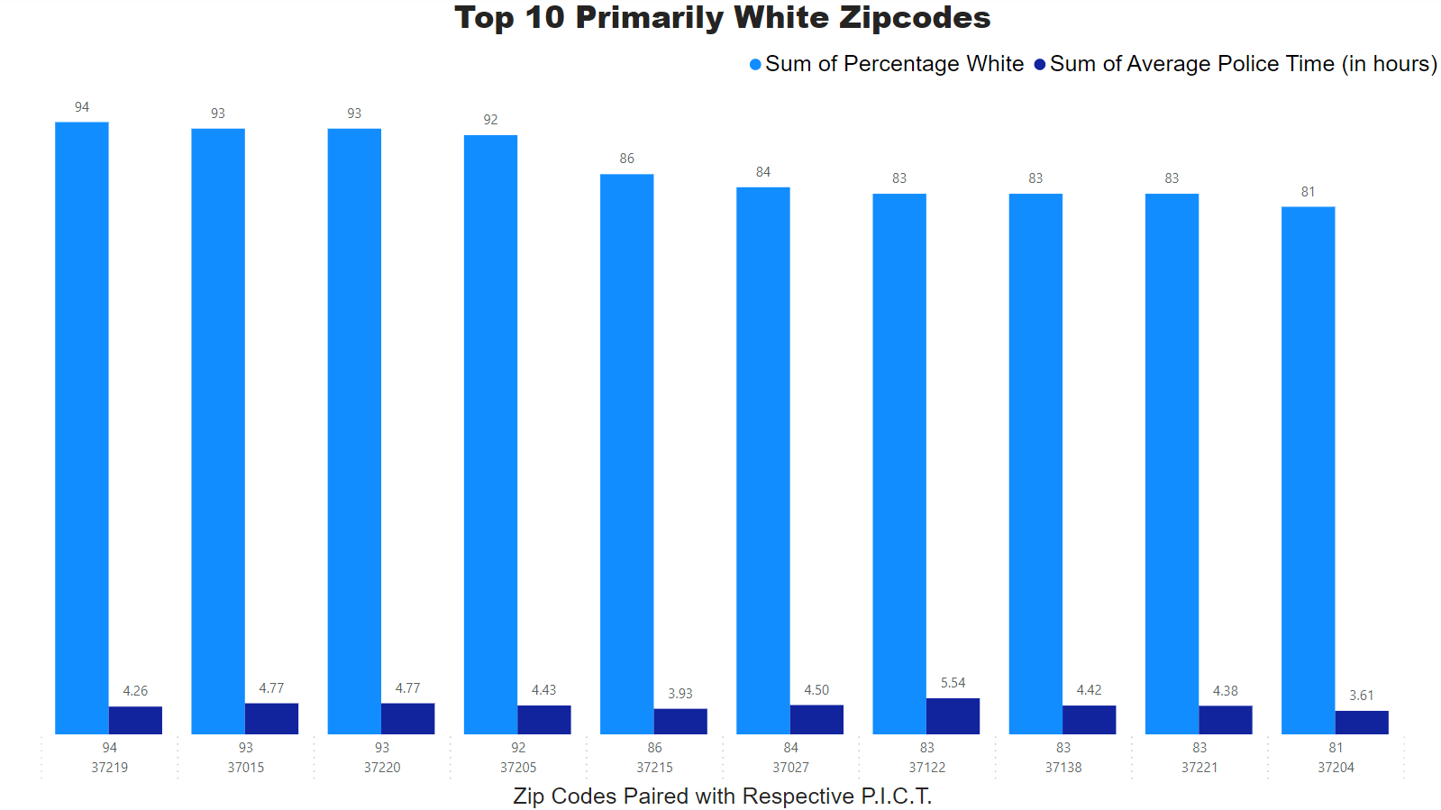
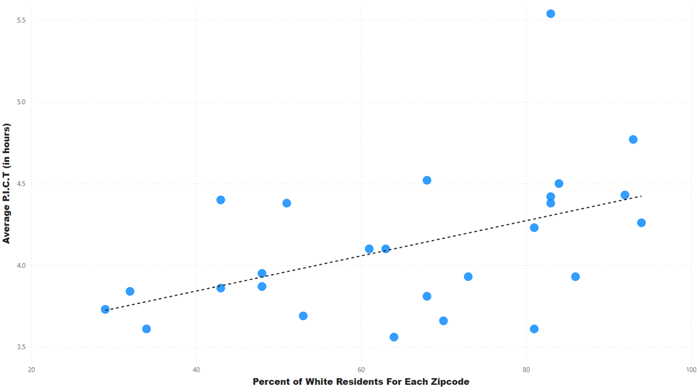
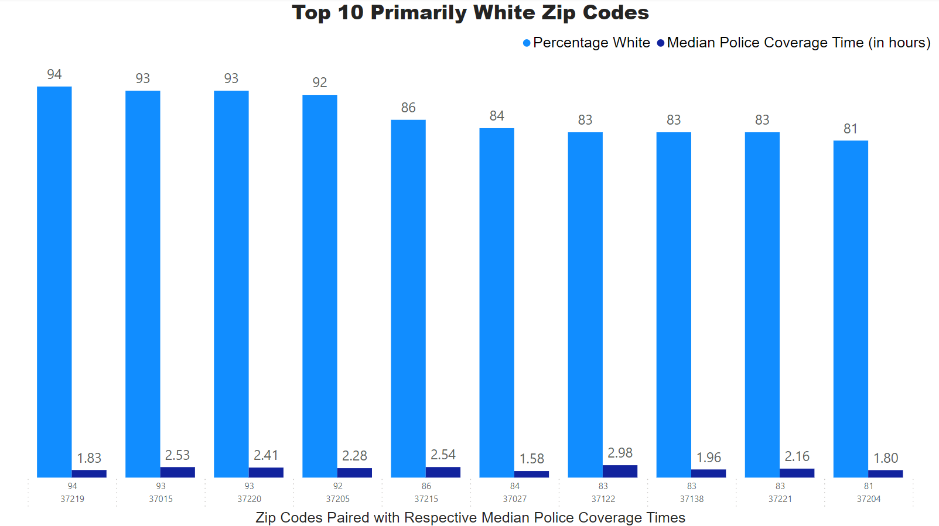
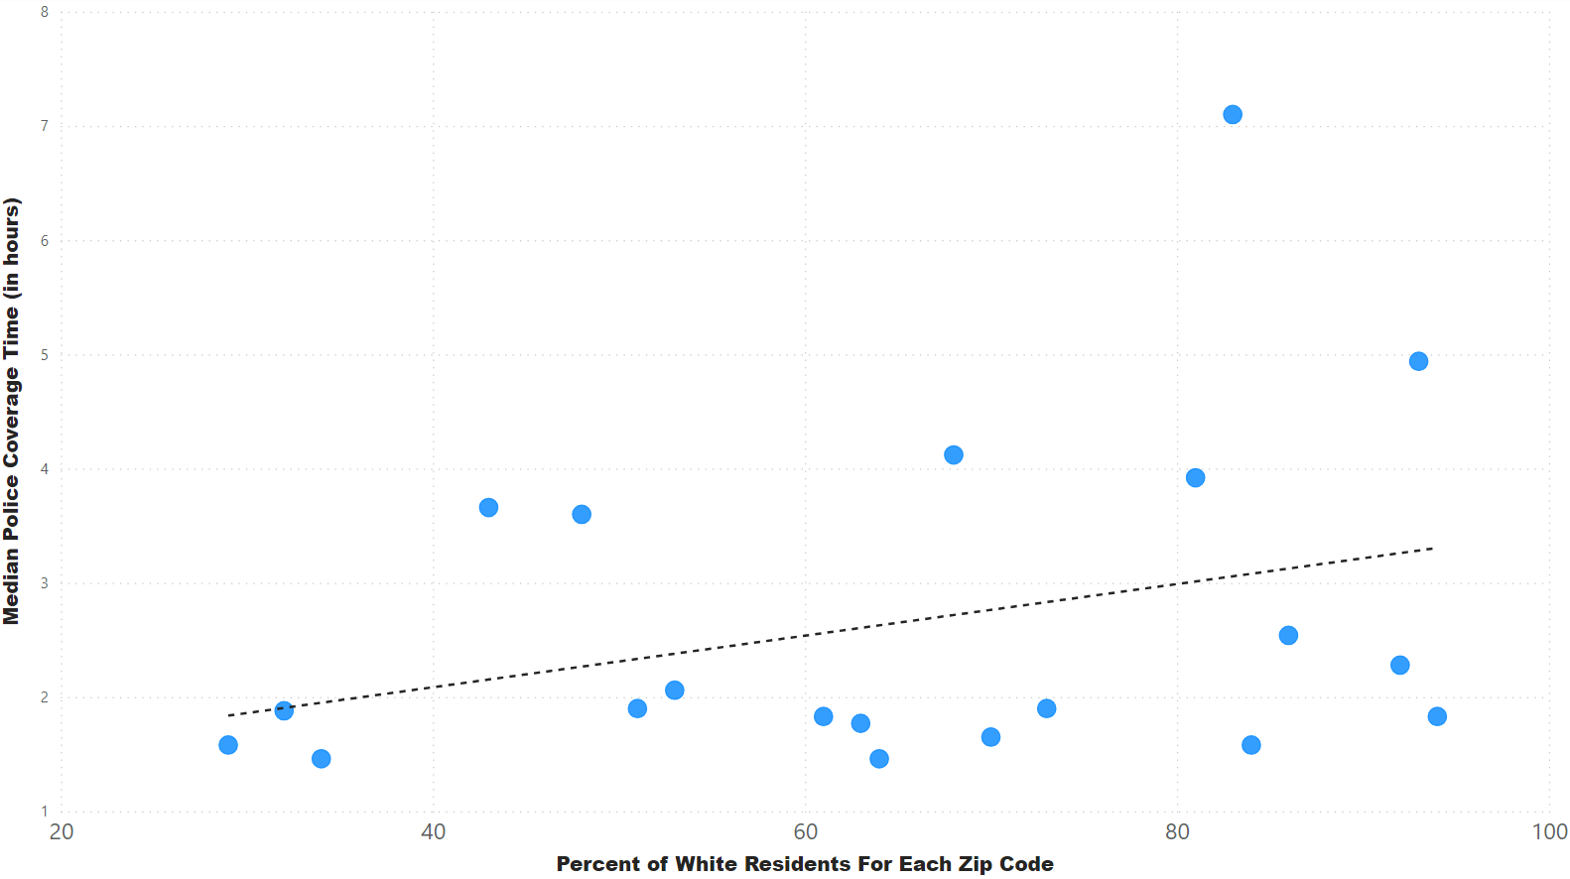
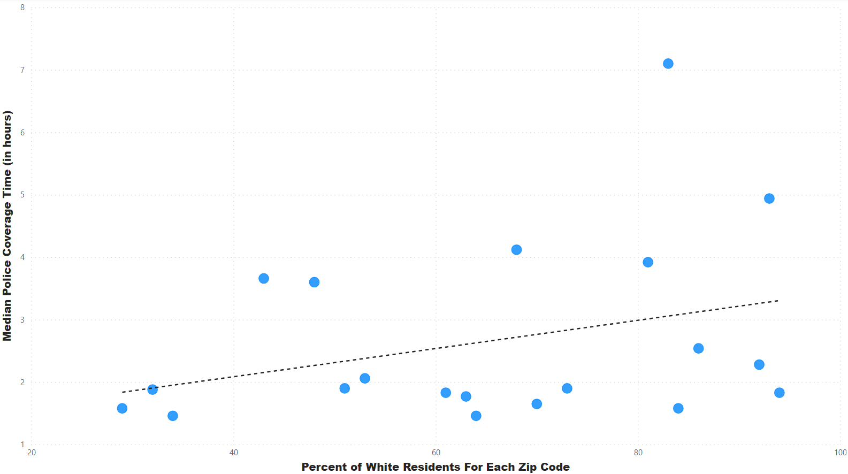
Primarily White Zip Codes With Correlation

Slide 8
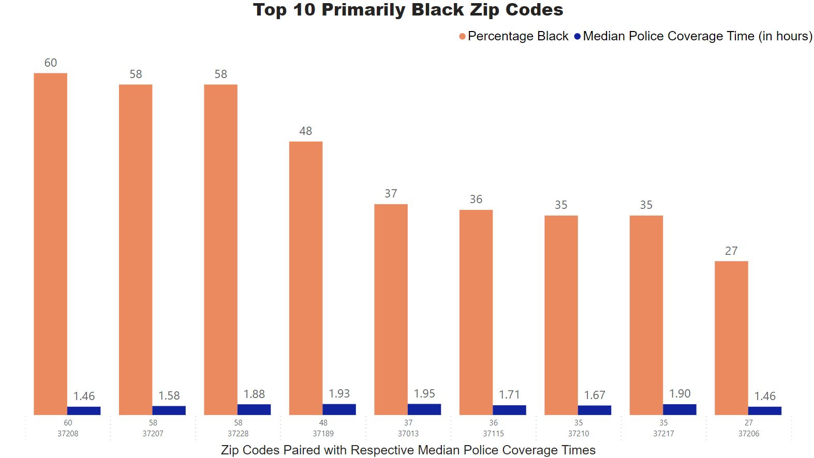

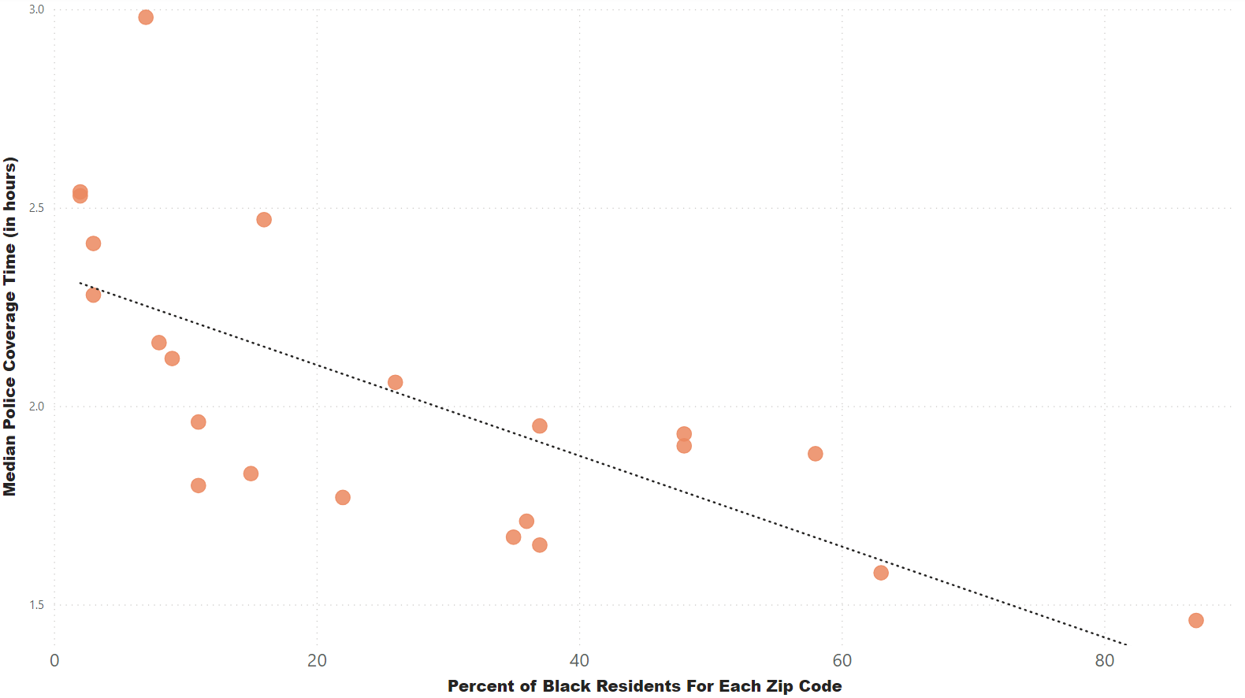
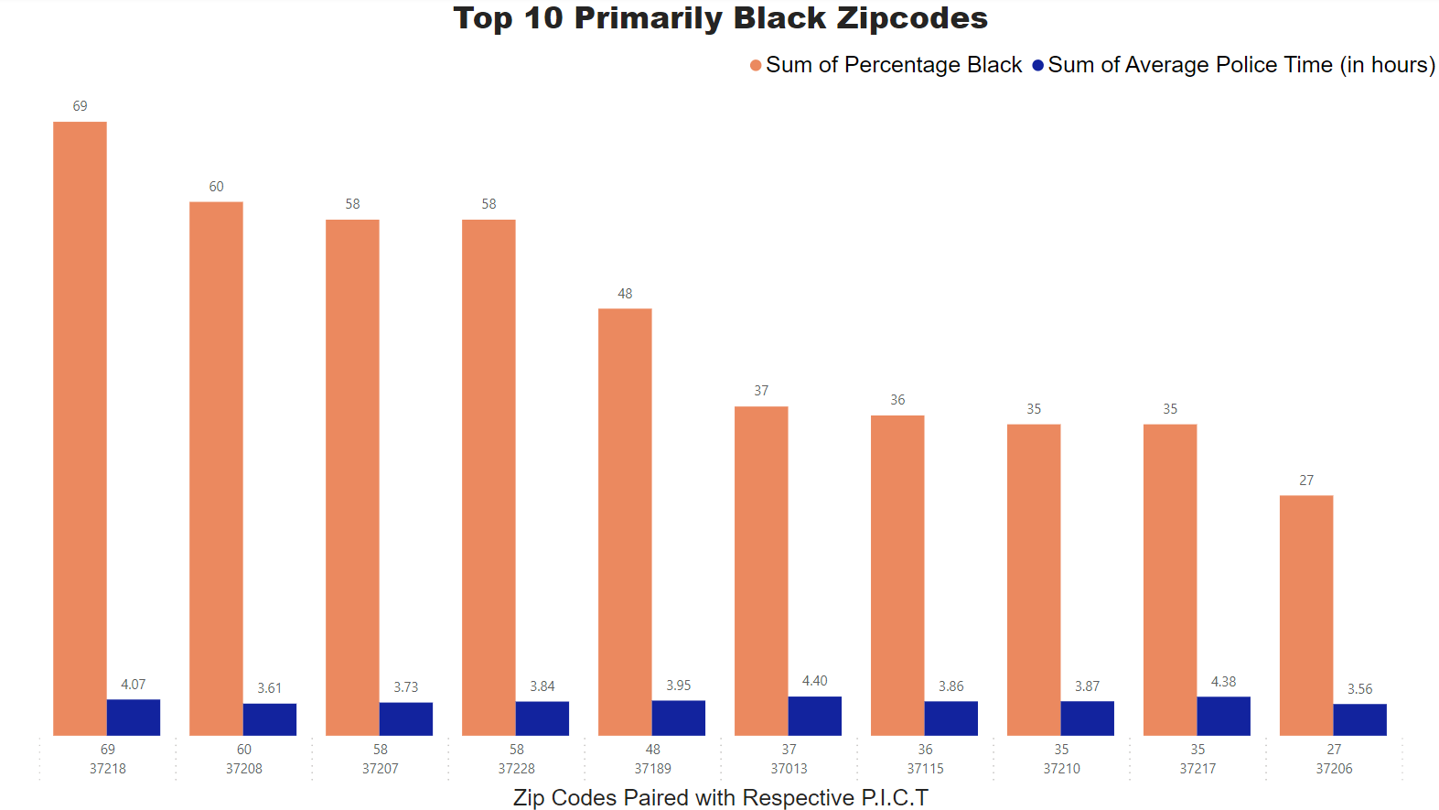
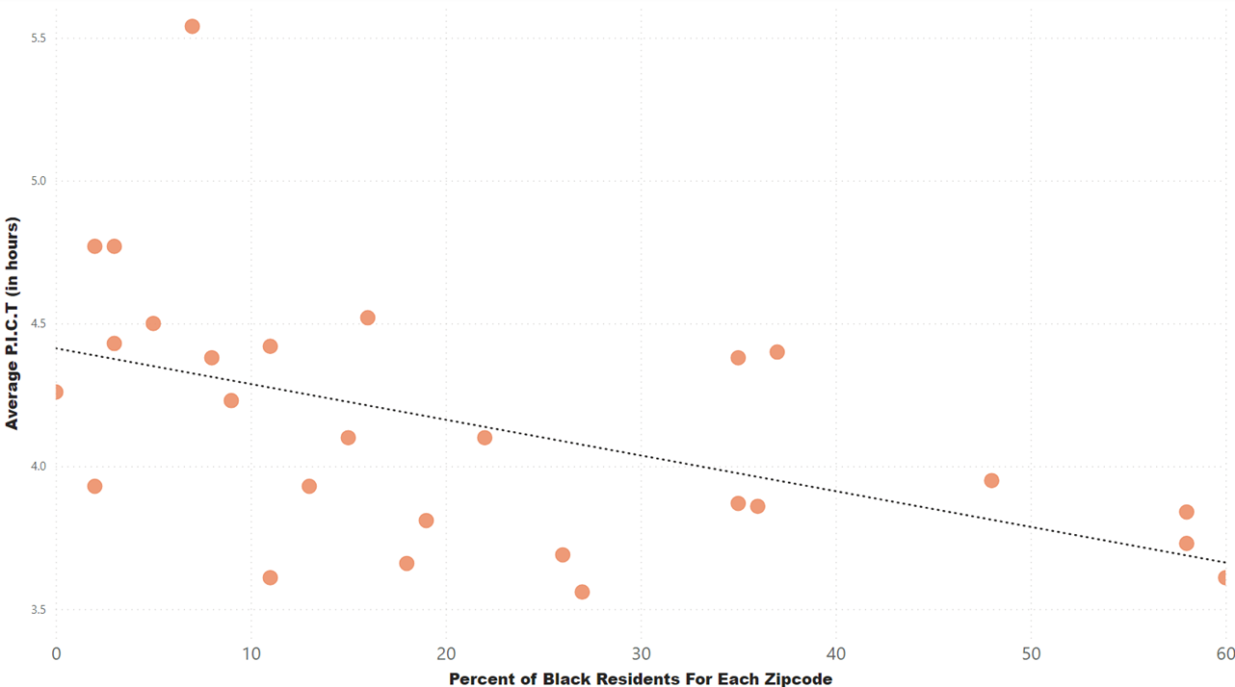
Primarily Black Zip Codes With Correlation

Slide 9
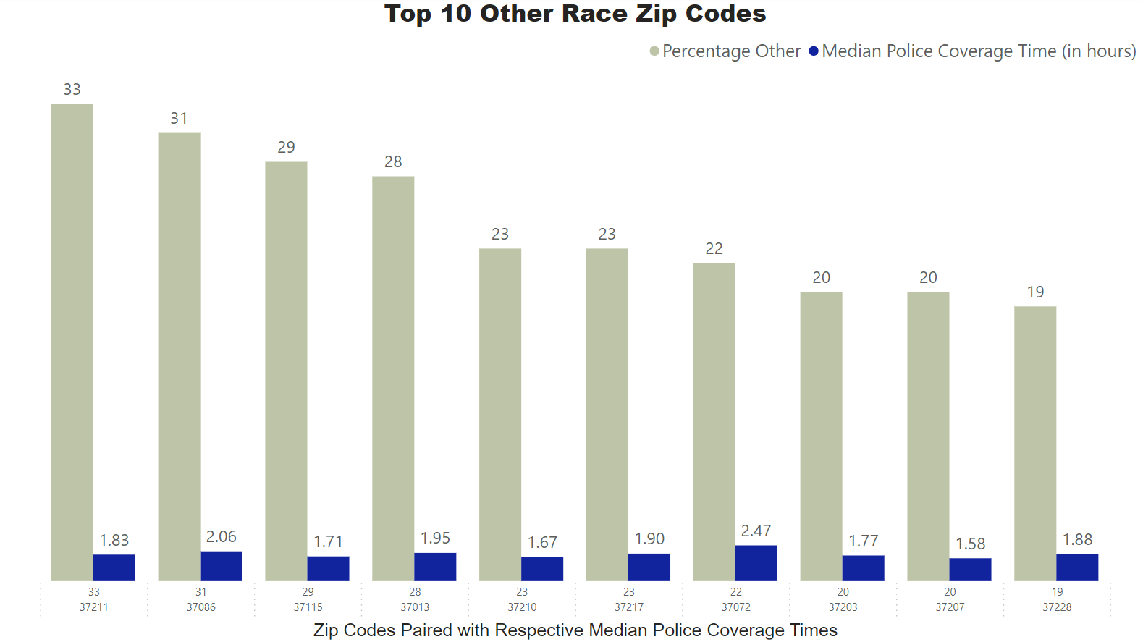
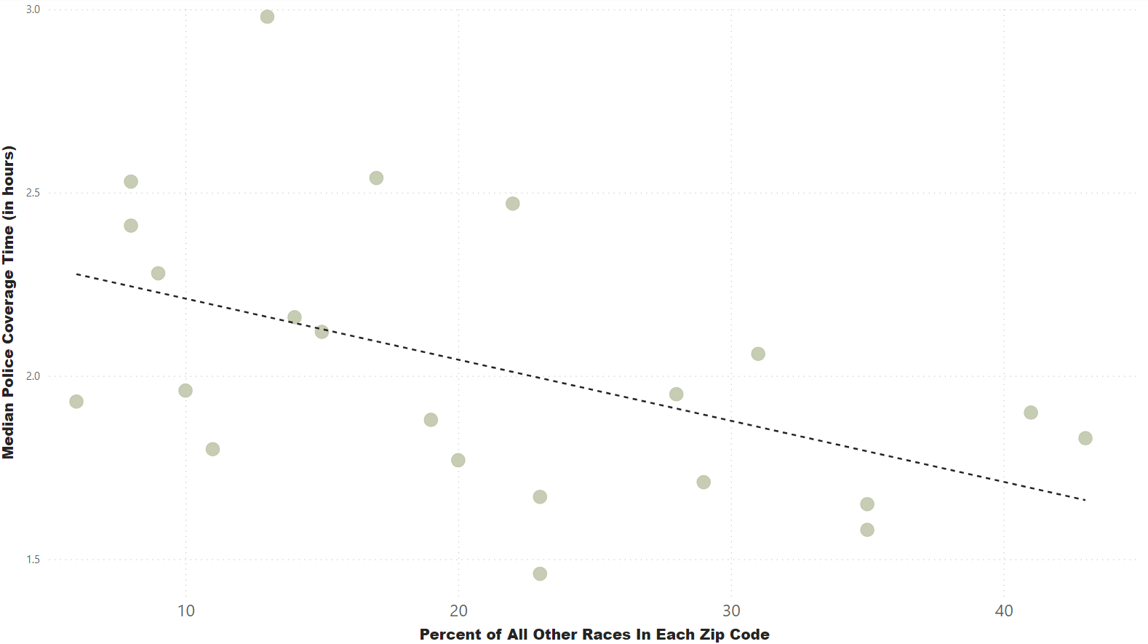
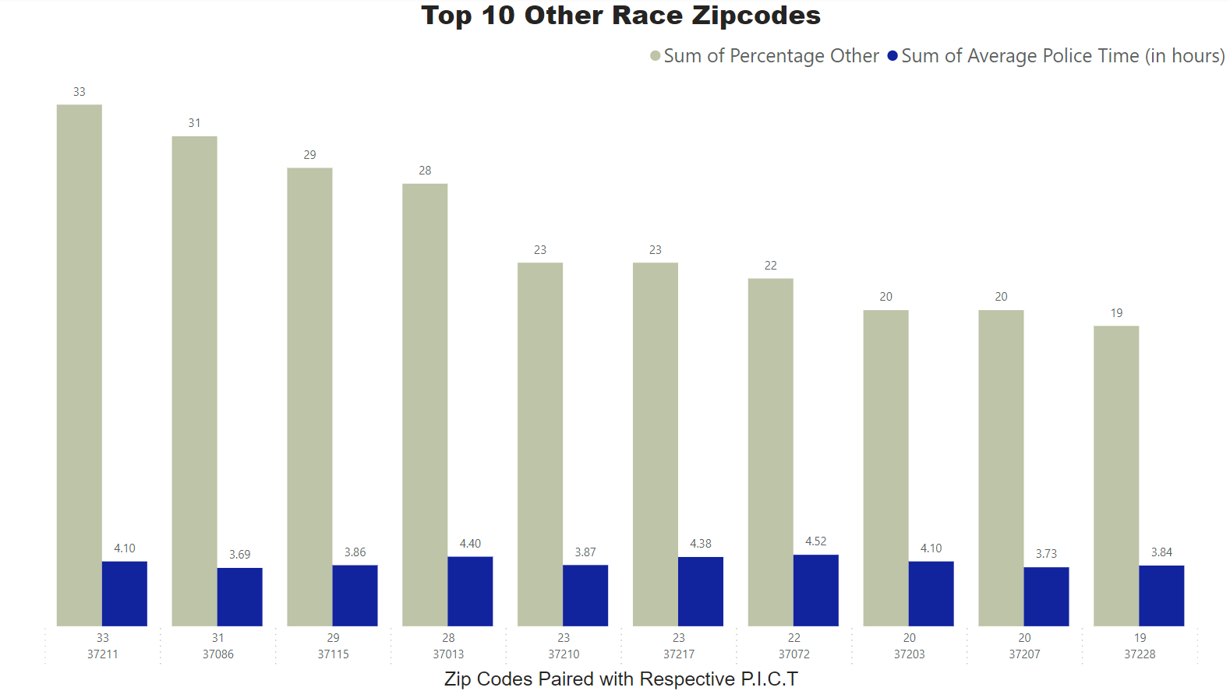
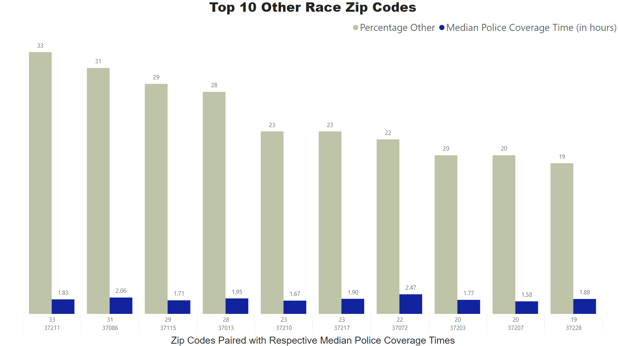
All Other Residents With Correlation

Slide 10
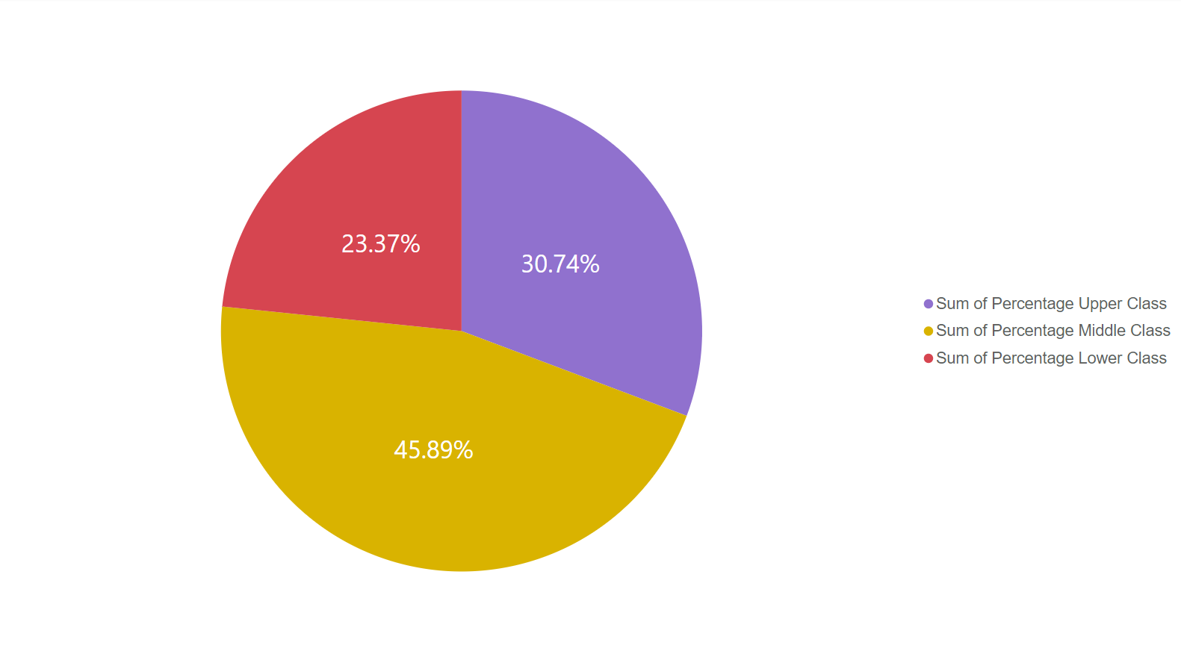
Income In Nashville
Lower Class – approx. $40k or less
Middle Class – $40k to $120k
Upper Class – more than $120k
Purple – Upper Class
Yellow – Middle Class
Red – Lower Class

Slide 11
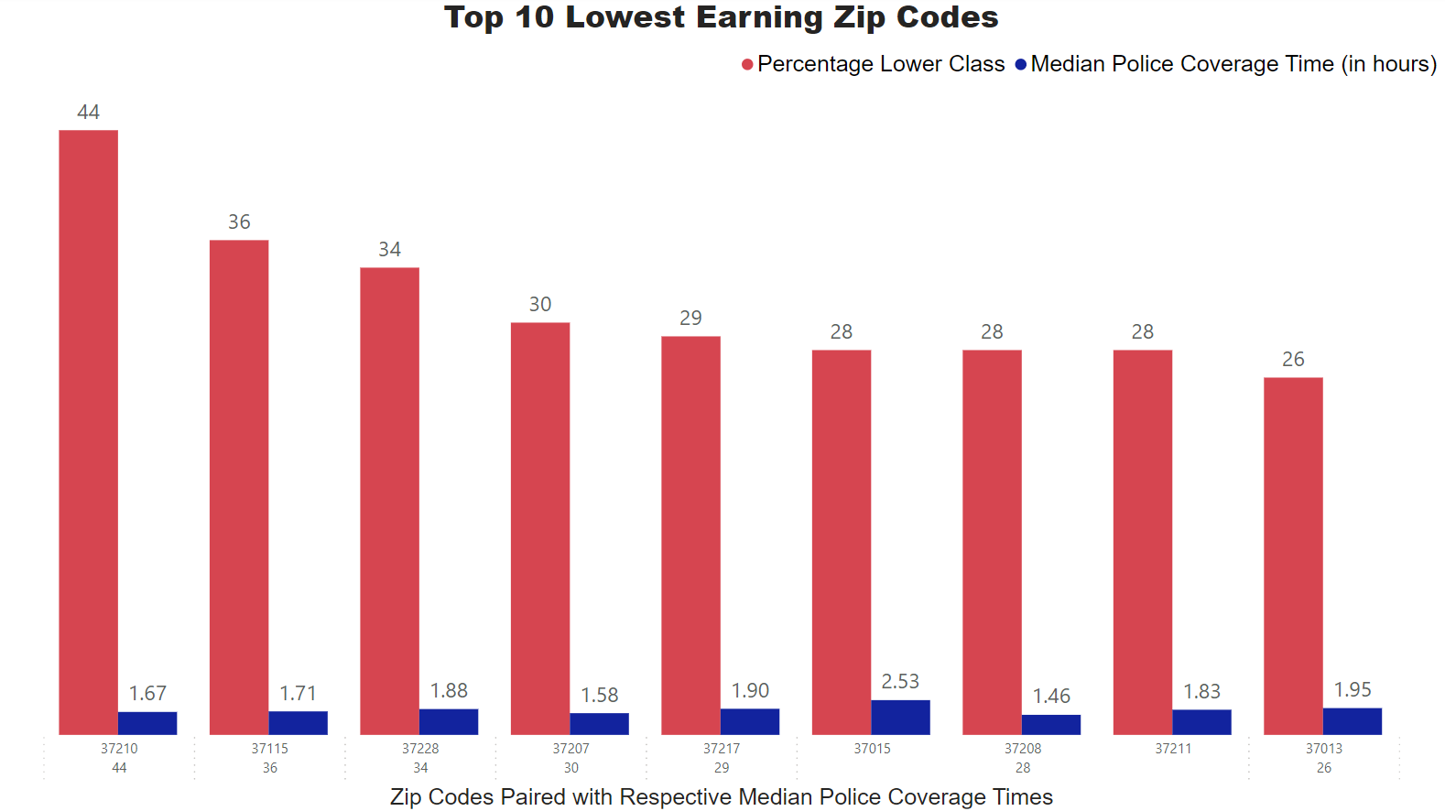
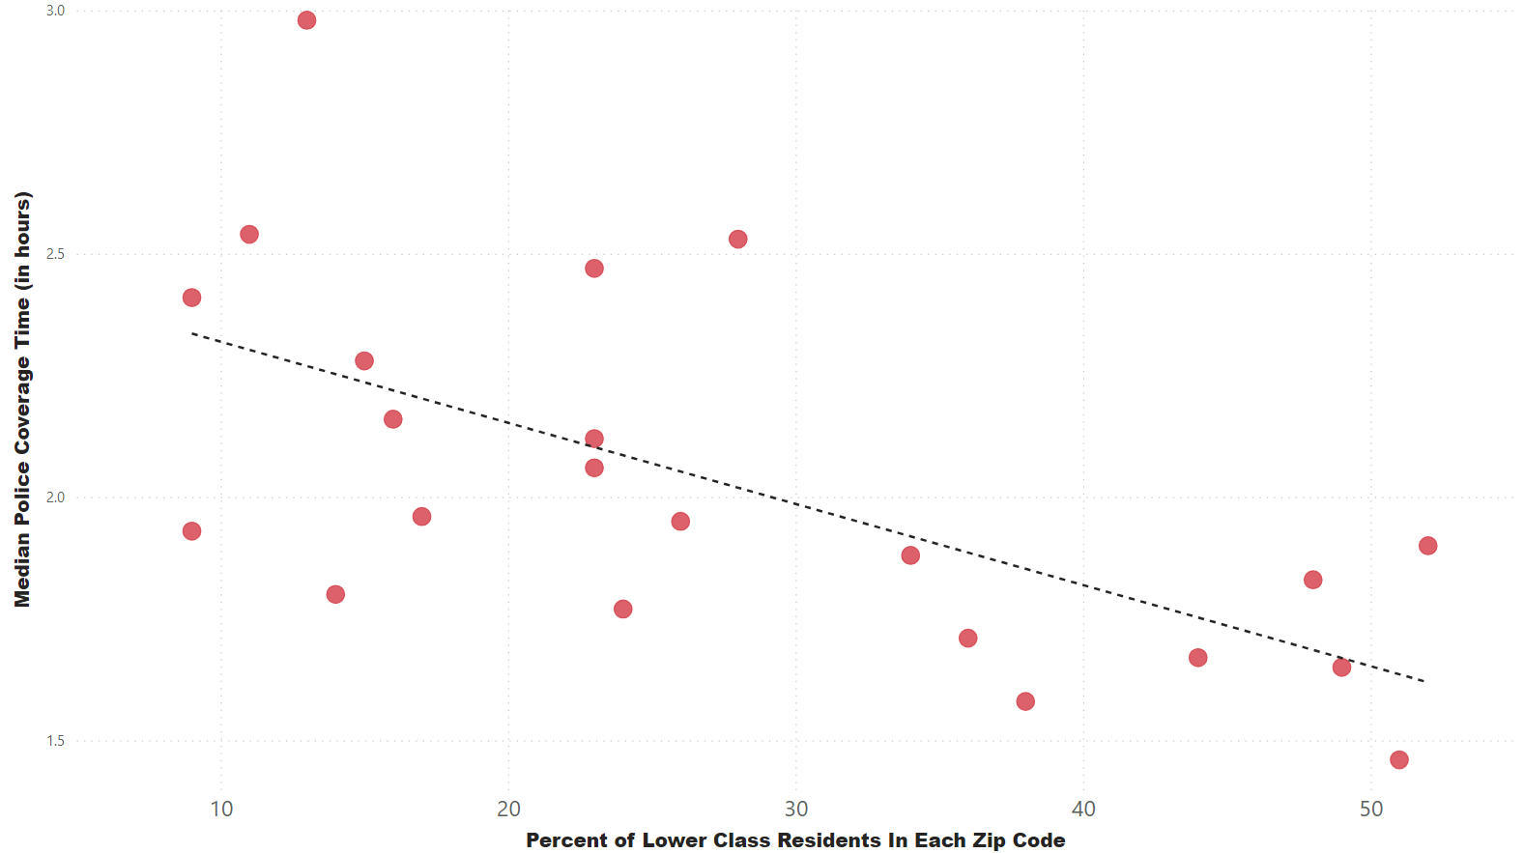
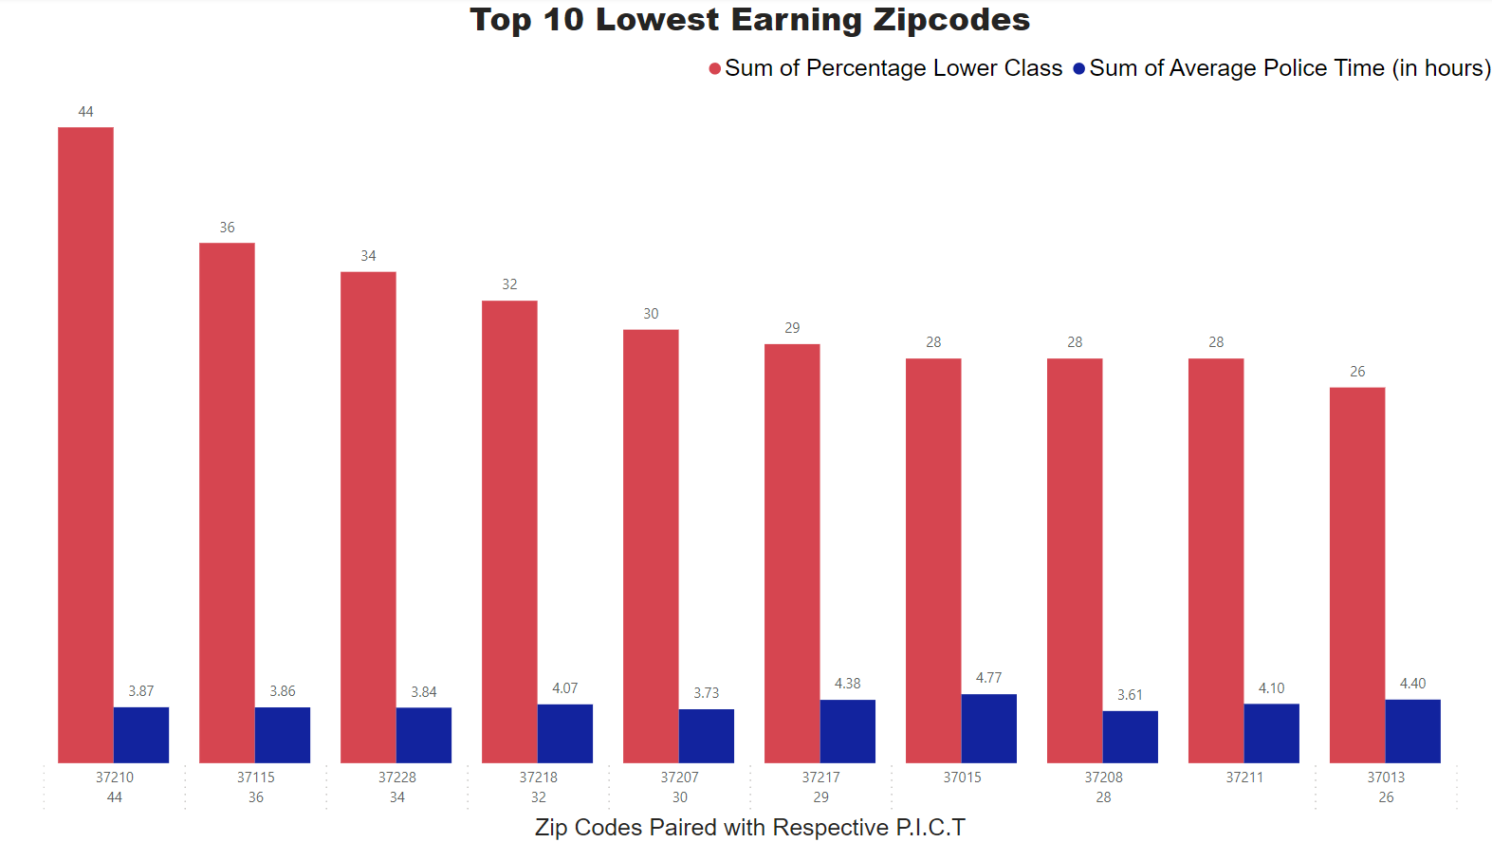
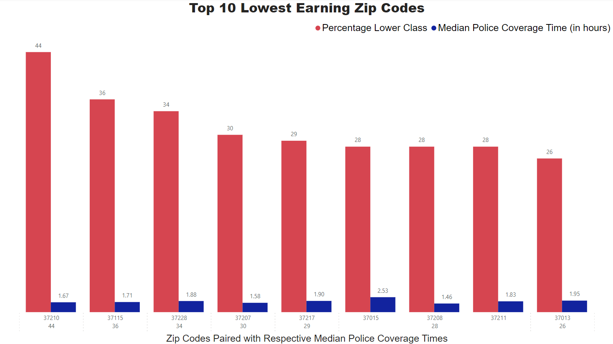
Lower Class Earners With Correlation

Slide 12
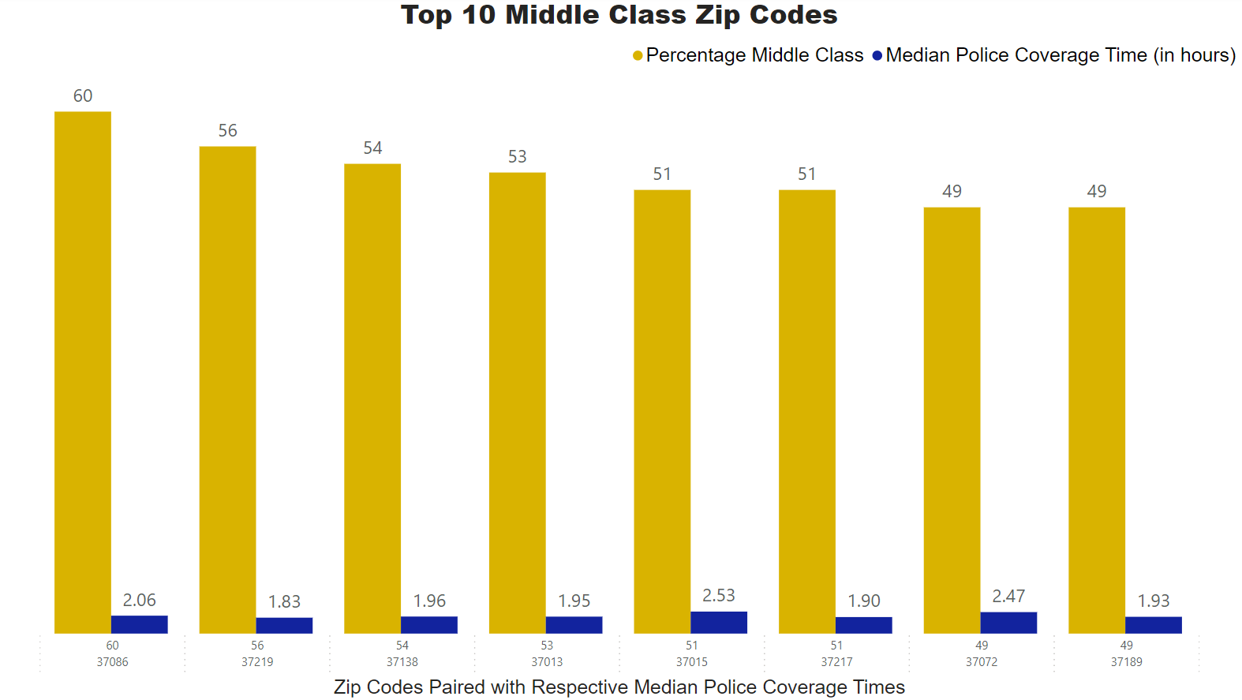
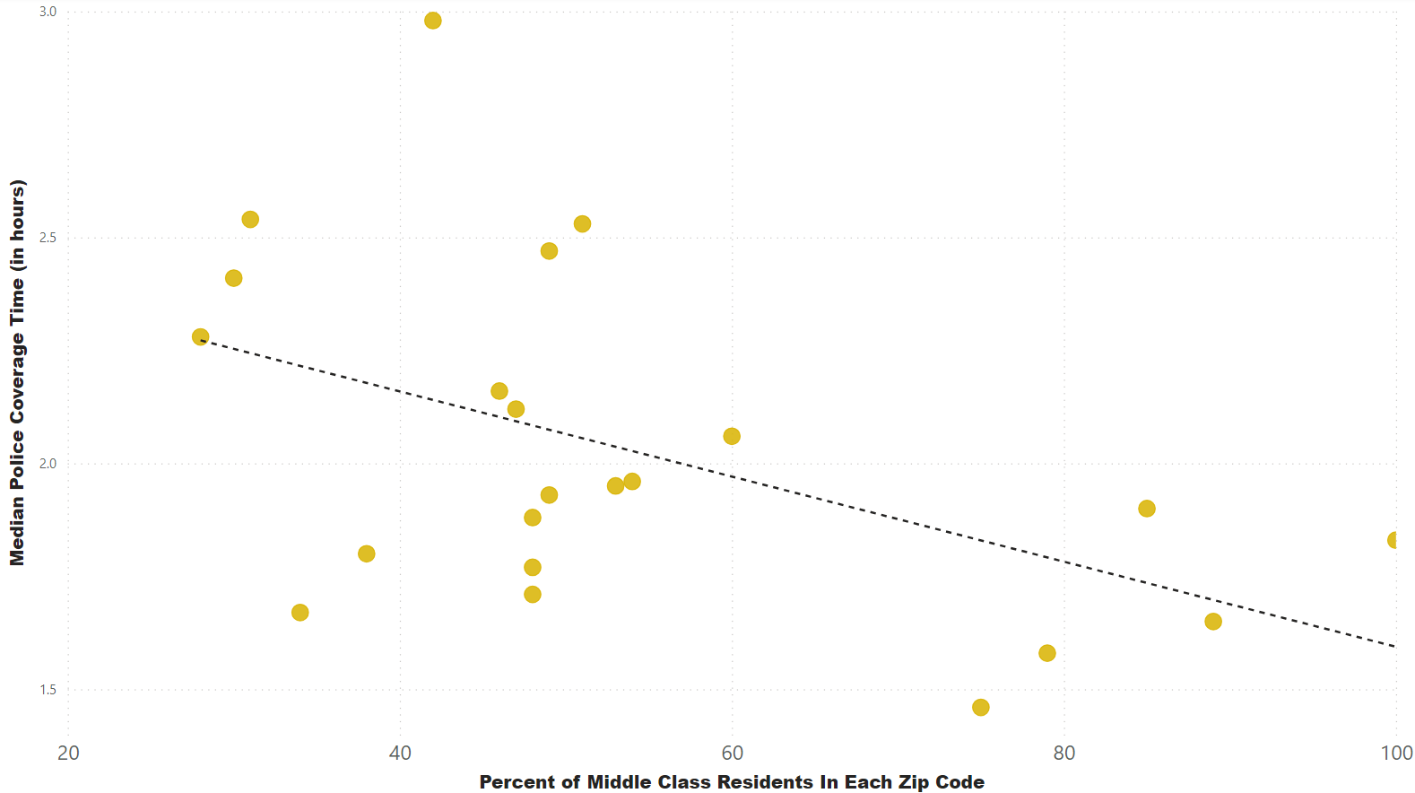
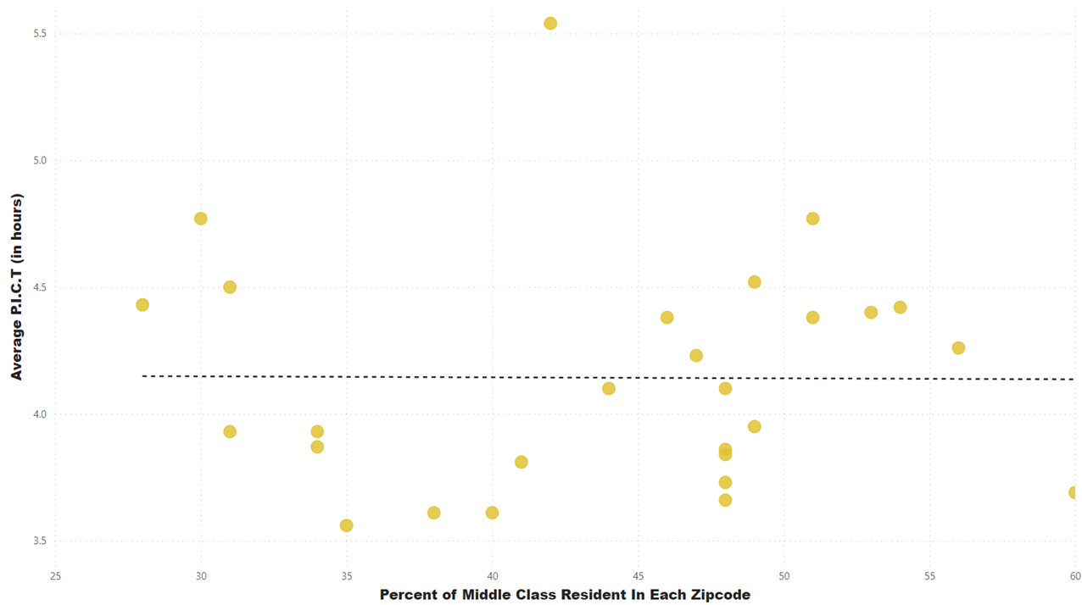
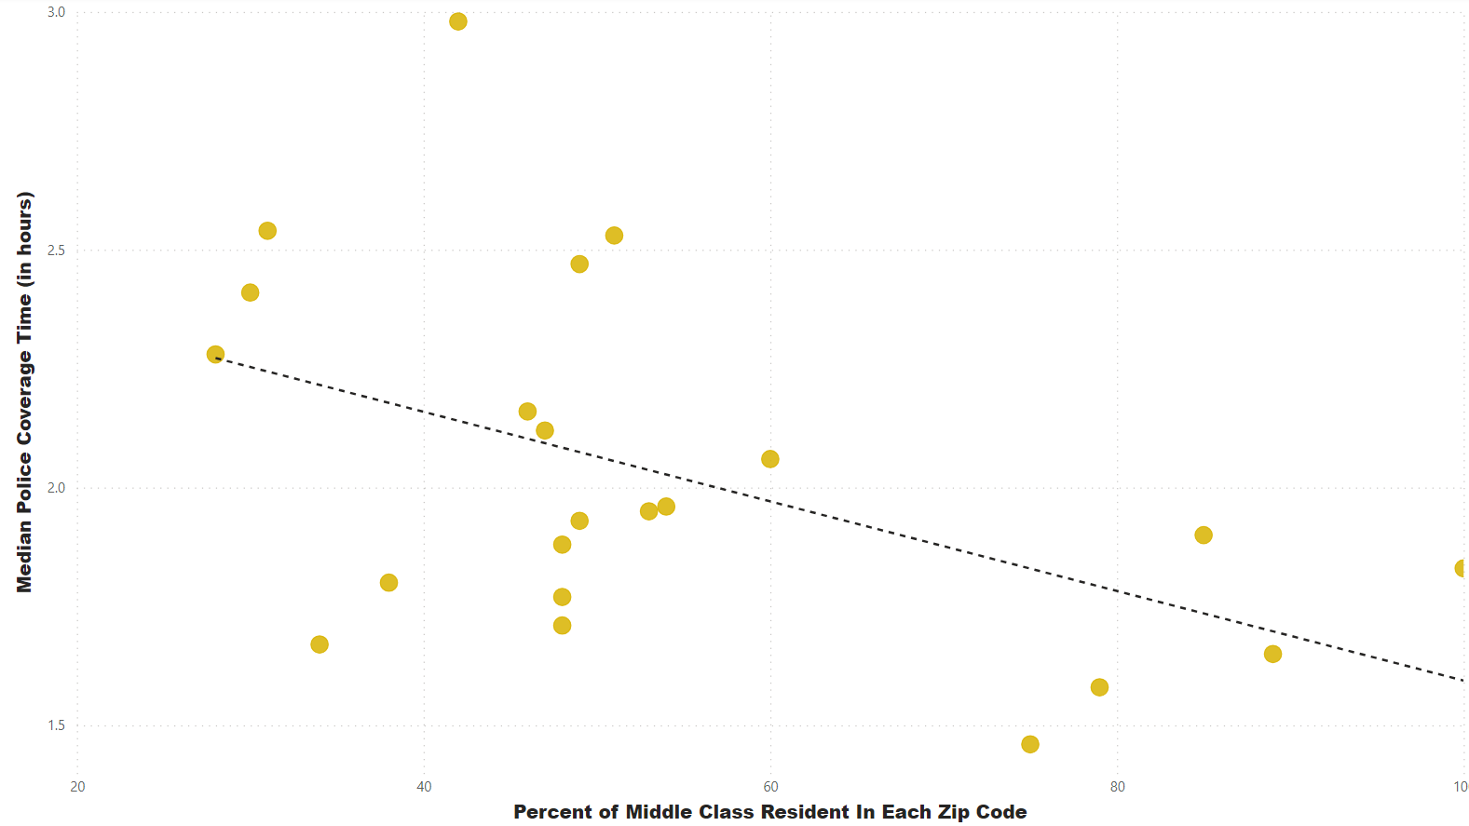
Middle Class Earners With Correlation
.

Slide 13
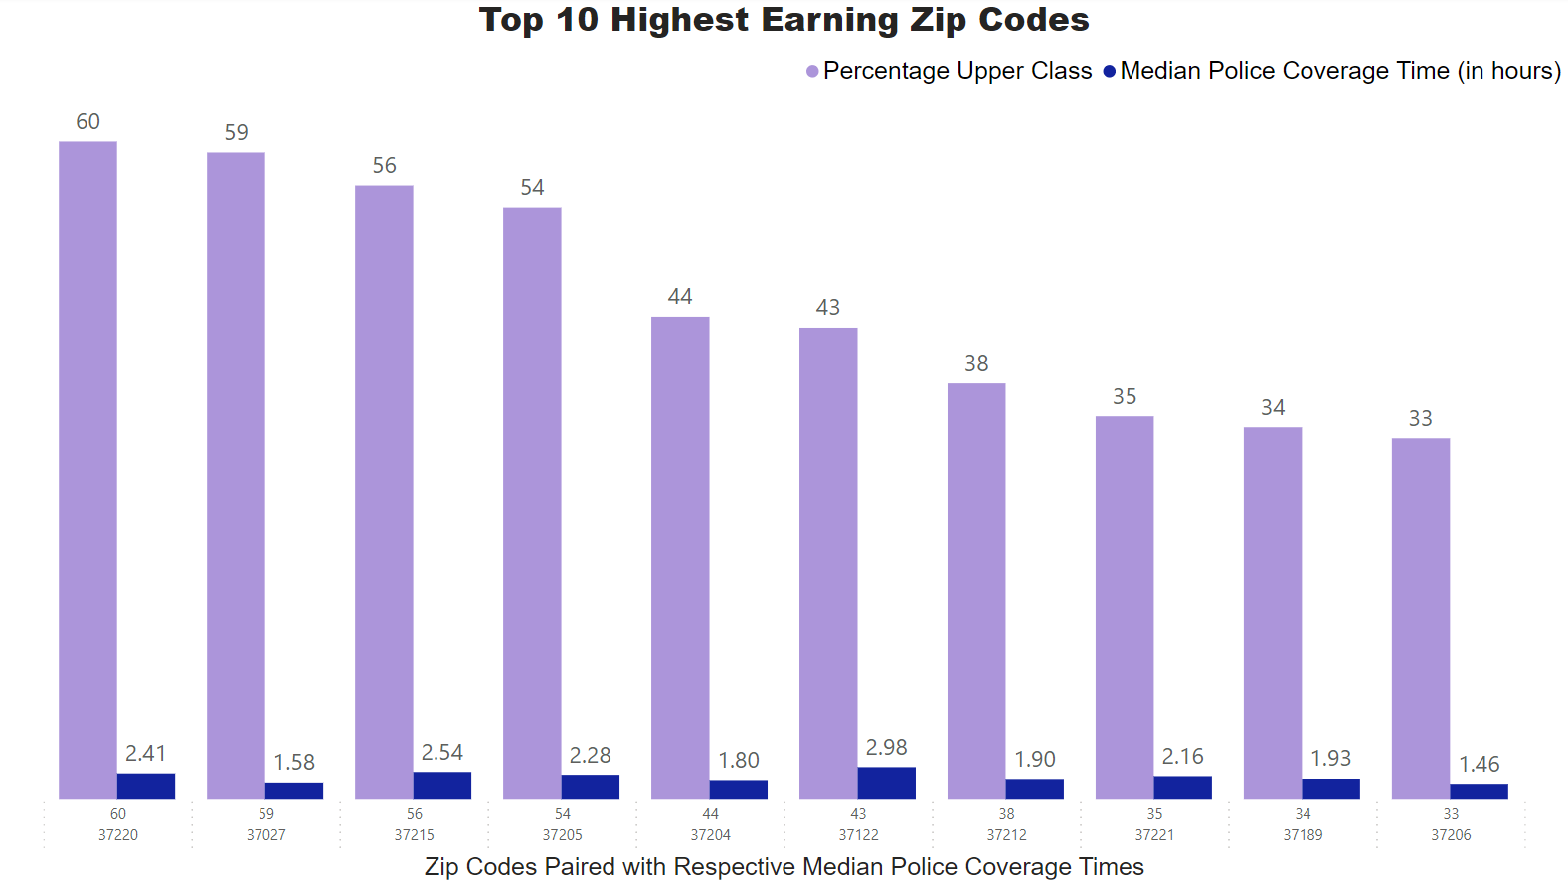
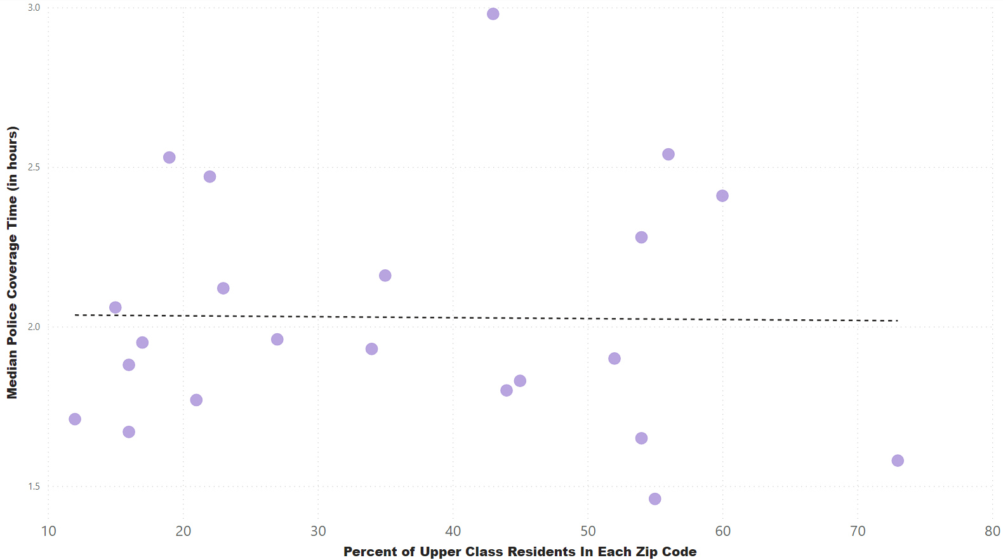
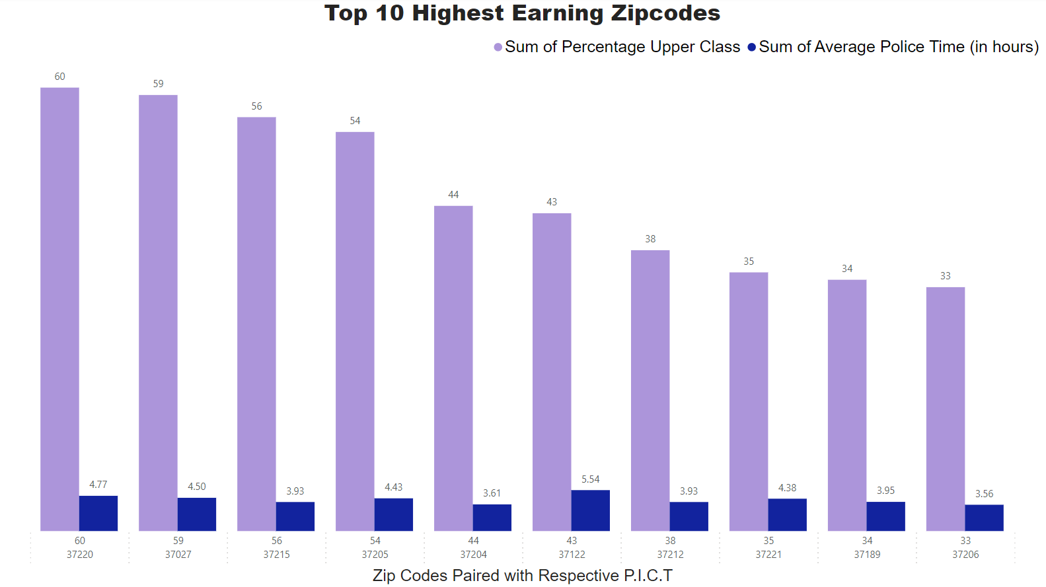
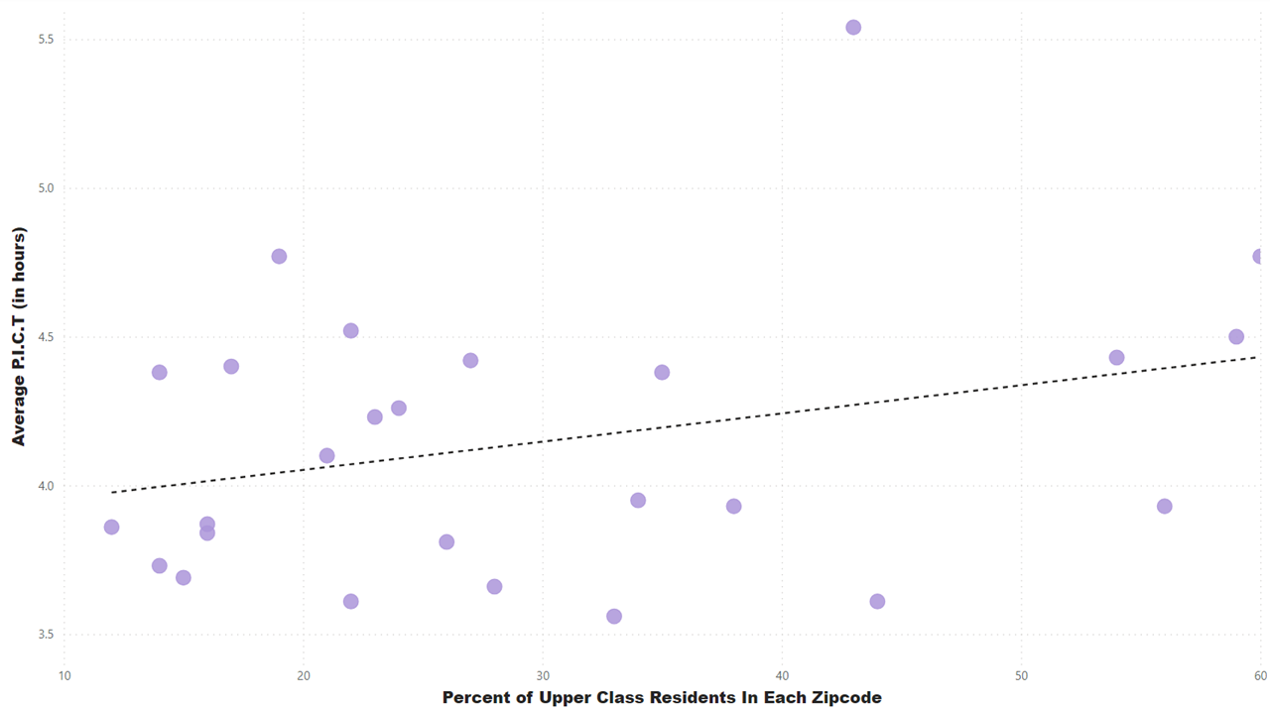
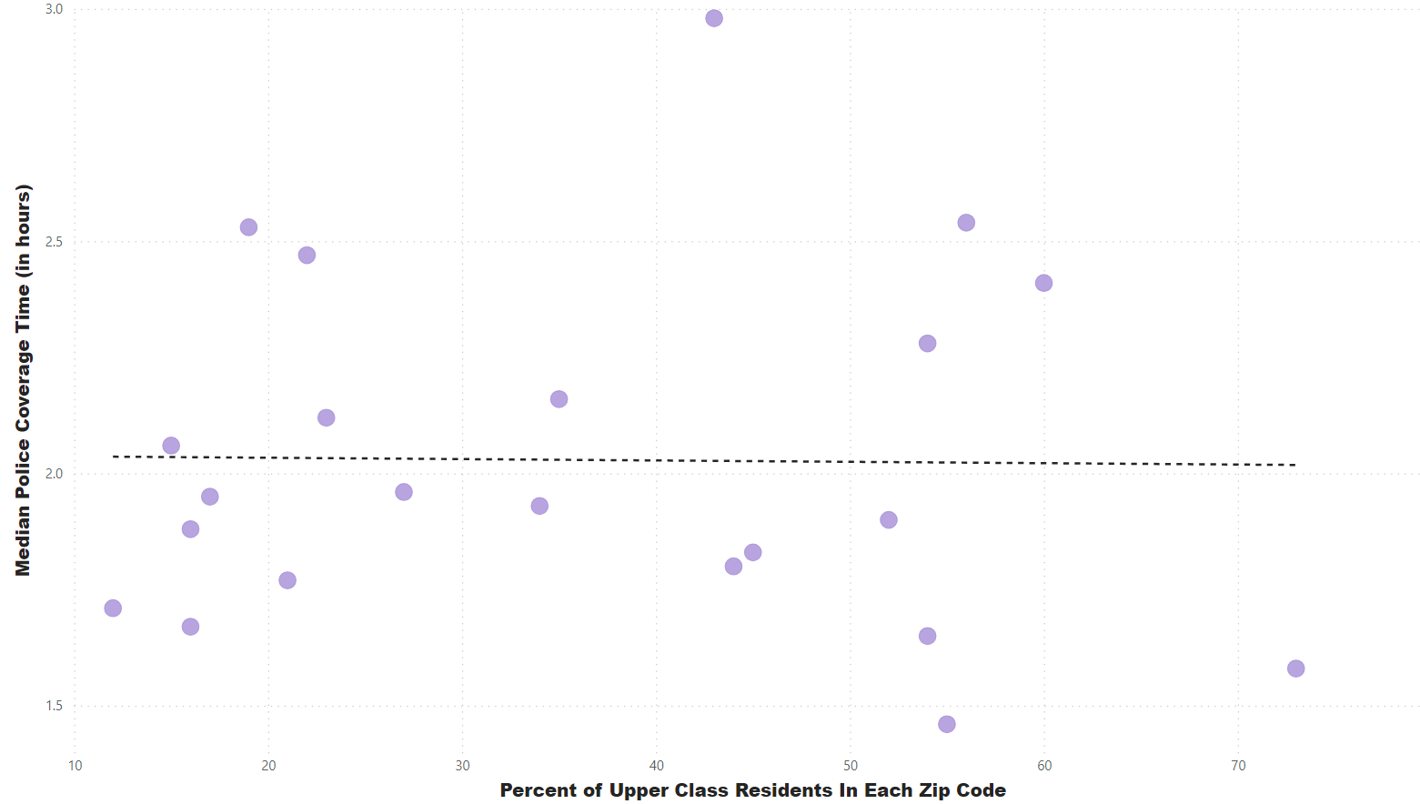
Upper Class Earners With Correlation

Slide 14
Additional Parameters
What are the top types of calls per zip code?
Does the type of call affect the time it takes for police to cover the call?
How quickly are the most frequent calls in Nashville covered?
How does coverage of a violent call measure against a nonviolent one?

Slide 15
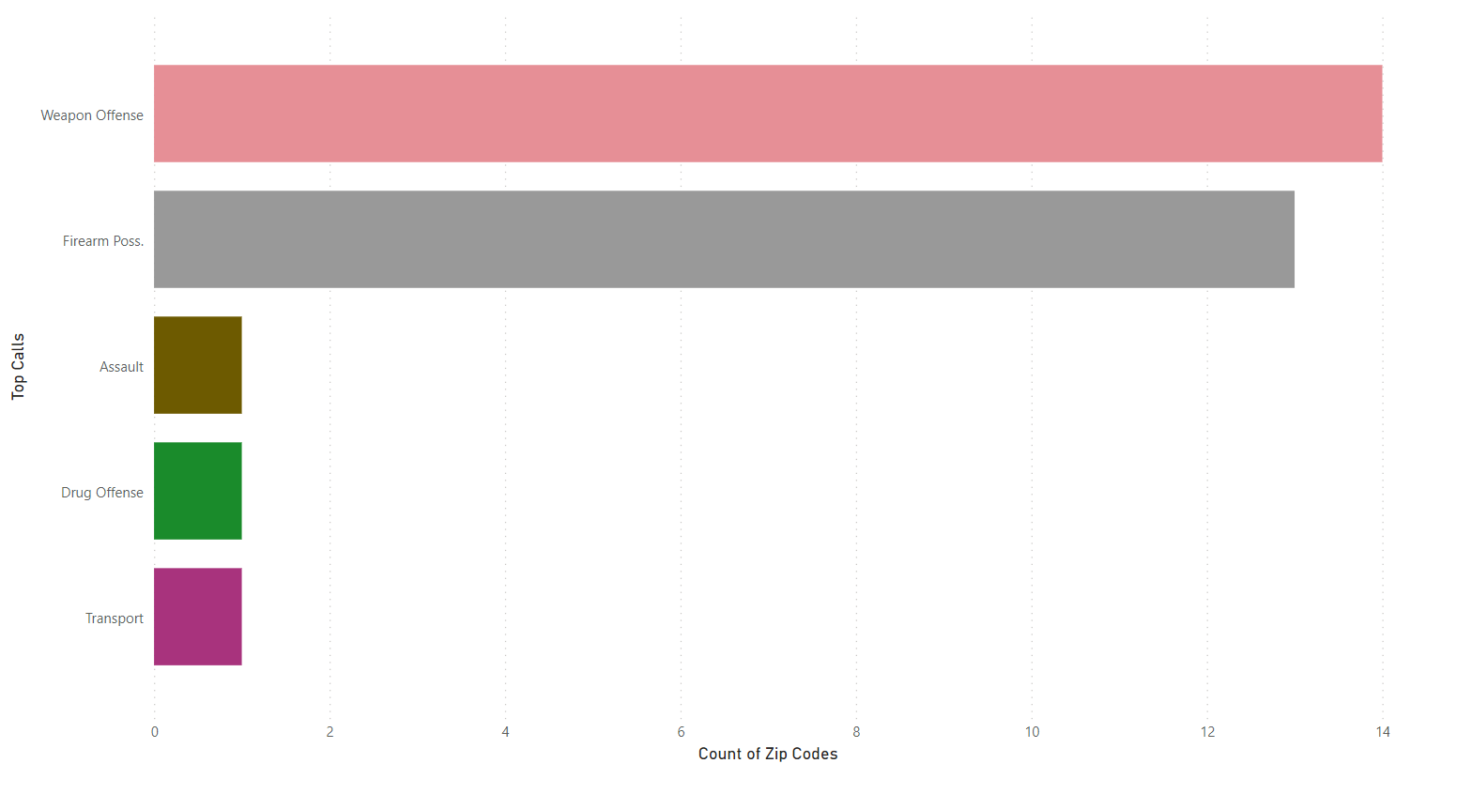
Top Types of Calls Per Zip Code in 2023

Slide 16
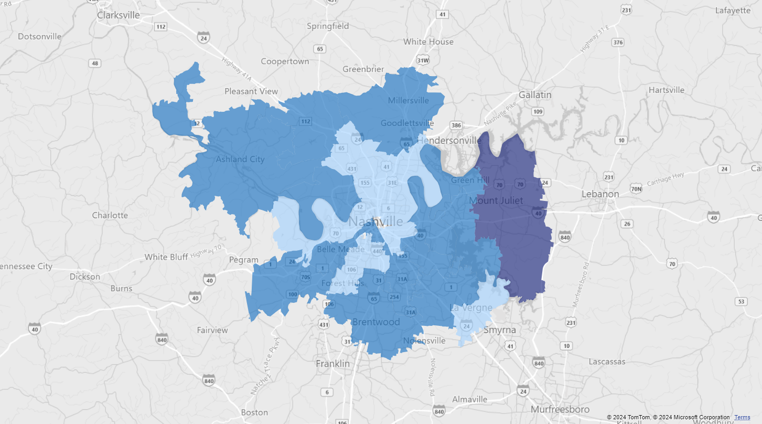
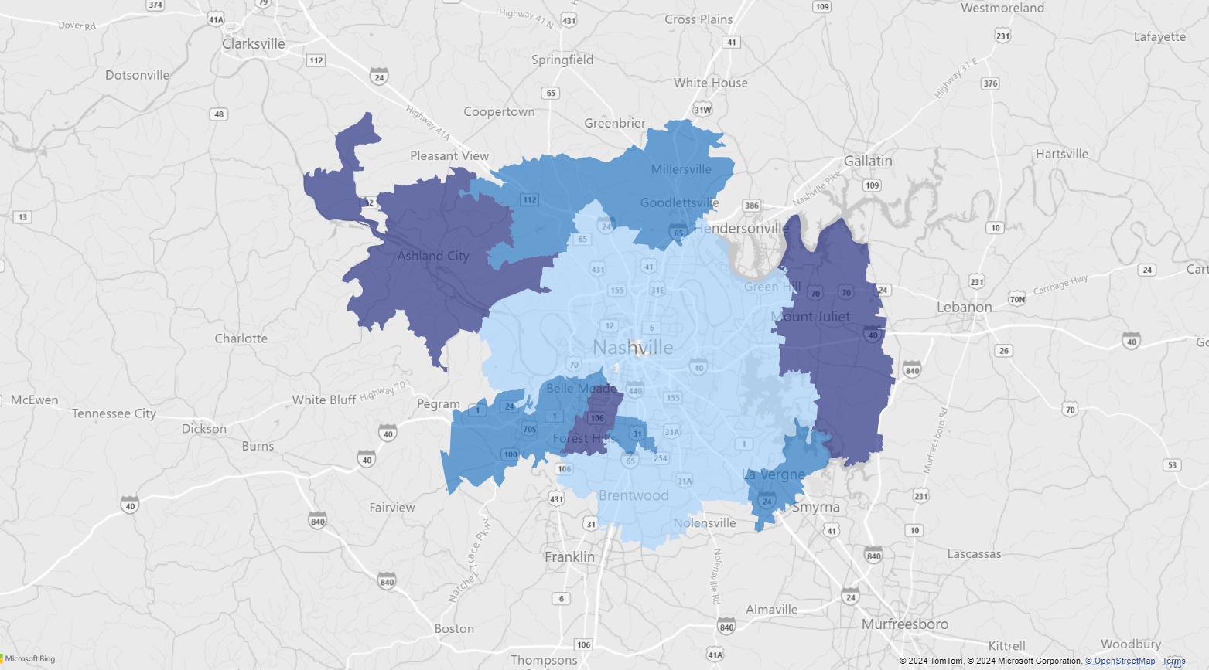
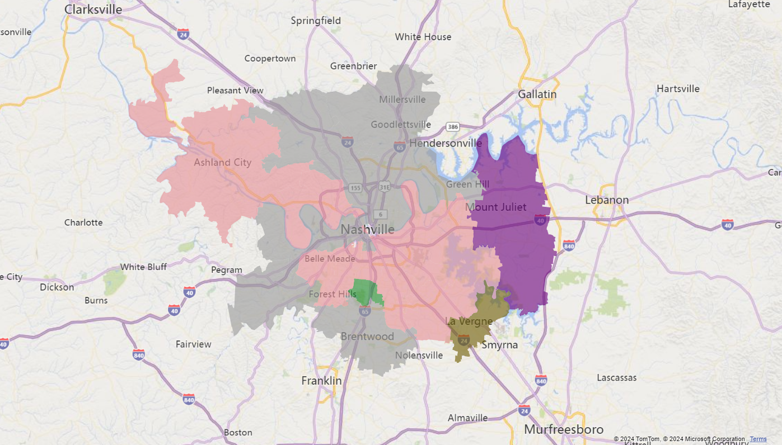
Average Police Times & Top Calls Per Zip Code in 2023
Weapon Offense – Light Pink
Firearm Possession - Grey
Assault - Brown
Drug Offense - Green
Transport - Purple
Light Blue – 1.5 - 2 Hours
Median Blue – 2 - 2.5 Hours
Dark Blue – +2.5 Hours

Slide 17
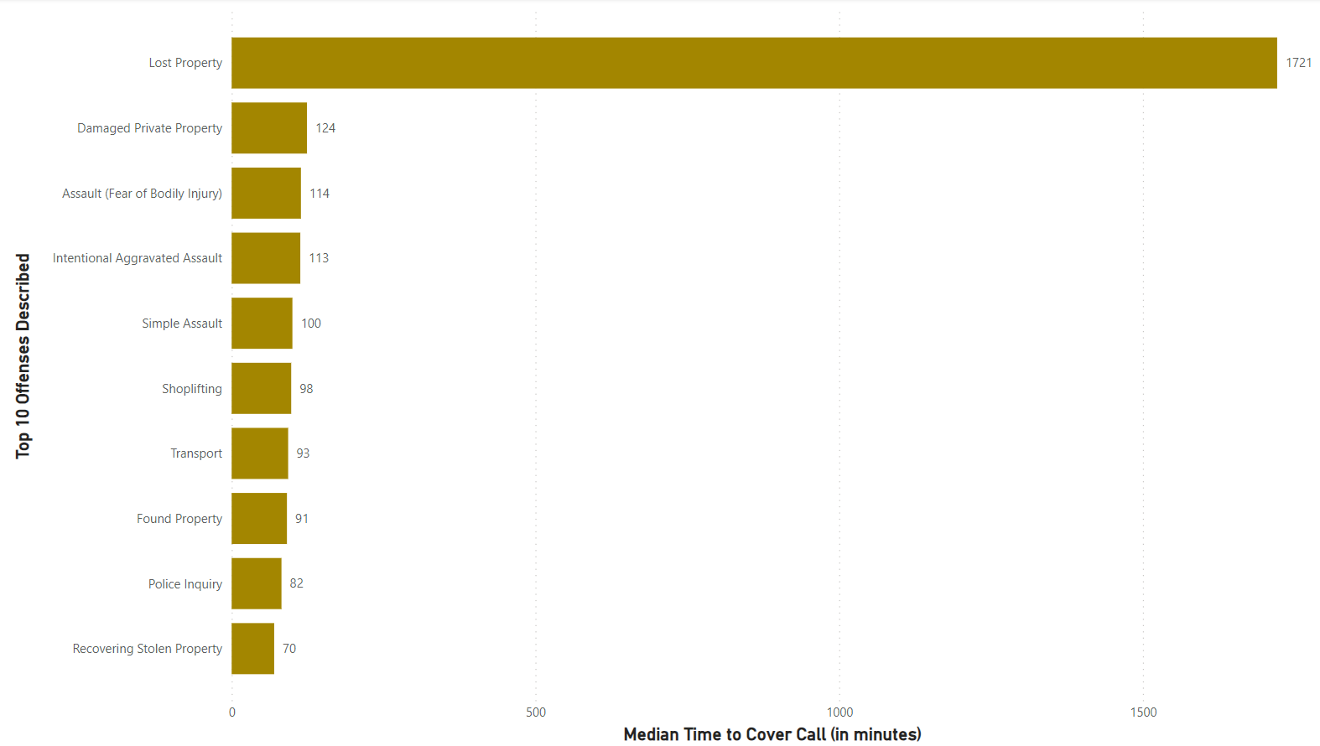
Top 10 Most Frequent Calls Across Nashville

Slide 18
Violent & Nonviolent Calls for Service
400 different types of calls to dispatched police
Violent calls = calls of imminent danger or situations that could turn dangerous
Nonviolent calls = calls where there is no current threat of danger or the possibility of more danger

Slide 19
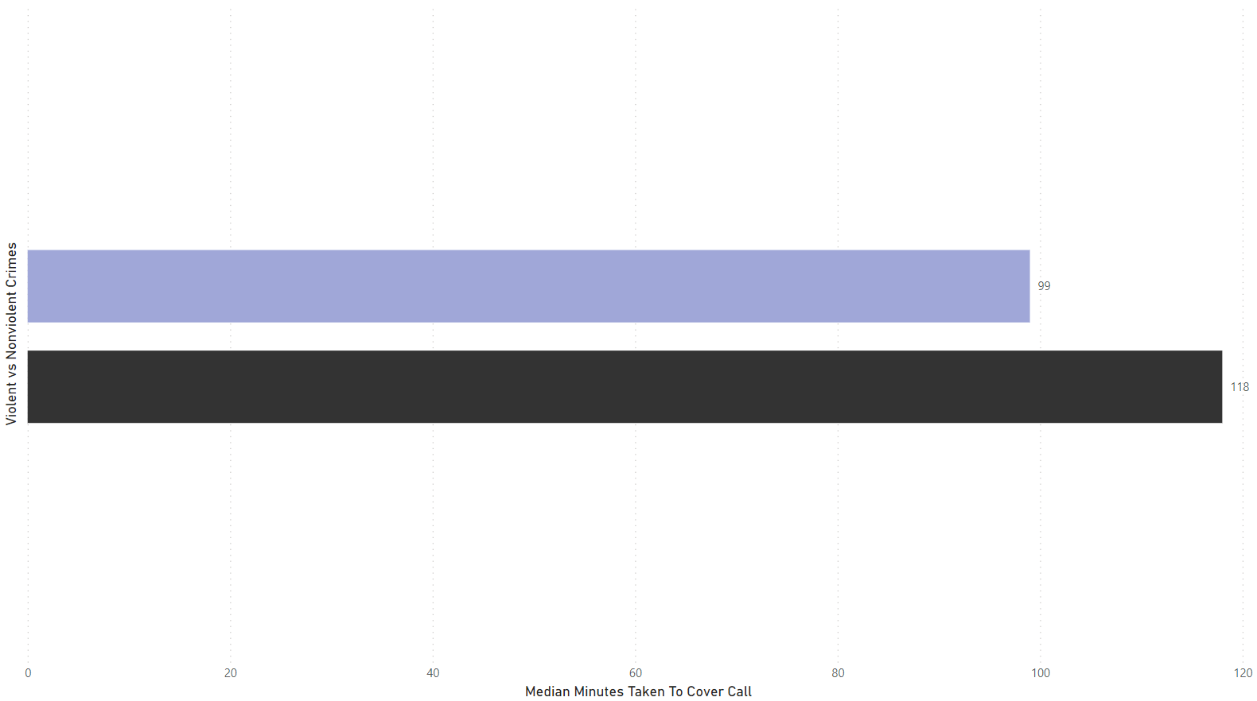
Median Police Coverage Times of Violent vs Nonviolent Calls (in minutes)
Nonviolent Calls - Lavender
Violent Calls - Black

Slide 20
Conclusion Based on Results
The findings seem to indicate that police in Nashville DO NOT discriminate against those of different races or incomes
ALL times for complete coverage of ALL crimes (apart from suspects on the run) averaged between about 1 and 3 hours.
It also appears that calls on situations that are nonviolent are handled slightly faster than those that are not
Nashville police appear to be slightly quicker in low income areas and areas with more minorities even though there is not a large spread of time taken between different areas

Slide 21
Data Used
https://censusreporter.org/
https://data.nashville.gov/Police/Metro-Nashville-Police-Department-Incidents/2u6v-ujjs/about_data
https://www.nashville.gov/departments/police
Study: How much do you need to make to be middle class in Nashville? (wsmv.com)

Slide 22
QUESTIONS ???

